Slide 1
FTSE Russell
Capital Markets Authority – Kuwait
Conference March 2018
Gary Rynhoud, Head of Middle East and Africa, FTSE Russell

Slide 2
London Stock Exchange Group Building stable, trusted markets since 1801
Post Trade Services
Information Services
Capital Markets
Selected LSEG business lines and areas of focus
Notes:
2

Slide 3
Why FTSE Russell?
A global index provider with local expertise in all major markets and across all asset classes that provides you with a true multi-asset index solution.
A global index leader
~$15 trillion assets benchmarked to FTSE Russell indexes¹
221 million derivatives contracts based on FTSE Russell indexes traded globally on 15 exchanges in 2016.²
70% of active US equity institutional assets are benchmarked to FTSE Russell indexes.³
FTSE Russell indexes are used by:
98 / 100 top asset managers⁴
44 / 50 of the largest US plan sponsors⁴
10 / 10 top investment banks⁴
Indexing from all angles
Scale, depth & reach A single index provider with the scale, depth, and reach to meet your needs across asset classes, styles and strategies.
True multi-asset solution Established fixed income index business combined with our equity index expertise sets us apart, providing a true multi-asset solution.
Global perspective combined with local knowledge
Global perspective, local benchmarks We are at the heart of global markets, combining global perspective with the knowledge gained developing local benchmarks for markets around the world.
1) Data pro forma as of December 31, 2016 for FTSE Russell and Citi Fixed Income Indices. Data as reported on March 31, 2017 by eVestment for institutional assets, Morningstar for retail mutual funds, insurance products, and ETFs, and additional passive assets directly collected by FTSE Russell. AUM data includes blended benchmarks and excludes futures and options. Passive assets directly collected by FTSE Russell have been removed from third party sources to prevent double counting. No assurances are given by FTSE Russell as to the accuracy of the data
2) Data as of December 31, 2016 as reported on March 31, 2017, for active US equity AUM based in the US, by eVestment for institutional assets.
3) Data as of December 31, 2016 as reported on March 31, 2017, for active US equity AUM based in the US, by eVestment for institutional assets. Source changed from Morningstar in 2014 to eVestment in 2015 to calculate institutional assets.
4) Based on FTSE Russell clients as of January 2017 and Pension & Investments lists for top Consultant, Money Manager and Asset Owner based on AUM (2016) and Dealogic (2016) data on investment banks.

Slide 4
A trusted partner
Many of the world’s largest asset owners and asset managers choose FTSE Russell to help them meet their specific business objectives and continue to innovate for the future.
Benchmark switches | Meeting regulatory requirements | Pioneering smart sustainability | Pioneering smart beta solutions
We supported Vanguard through the transition of six leading international equity funds to FTSE Russell benchmarks. The world’s largest emerging markets ETF, the “Vanguard FTSE Emerging Markets ETF (VWO)”, broke new ground as it became the first of its kind to offer China A-shares along with All Cap exposure. FTSE Russell supported this change with the launch of a new transition index to minimise market impact. | The Government of Hong Kong created the Mandatory Provident Fund (MPF), a defined contribution scheme, with compulsory participation by employers and employees. The Hong Kong Investment Fund Association and its advisors Willis Towers Watson turned to us to develop the FTSE MPF Index Series for their equity benchmark. The MPF WIGBI, now part of FTSE Russell’s fixed income indexes following the acquisition of the Citi fixed income indexes, is MPF’s fixed income benchmark. | We worked with the UK’s largest asset manager and the UK’s largest bank to pioneer a new green index solution with a risk/return-aware objective. HSBC has invested £4 billion of its UK employees’ pension savings in Legal & General’s Future World Fund, as pressure mounts on large investors to protect their portfolios from the risks associated with climate change. | One of the largest asset owners in the US turned to us when it considered portfolios based on fundamentals rather than market capitalisation. Working with Research Affiliates, we created the first smart beta indexes – spawning a new index category. FTSE RAFI indexes are now available for both equity and fixed income.

Slide 5
The indexing continuum. Demonstrating the completeness of the FTSE Russell offering available to our clients
Size
FTSE 250 Mid-Cap UK
Russell 1000 Large-Cap US
Russell 2000 Small-Cap US
Thematic
Dividend Yield Weighted
Geographic Exposure
Sustainable Yield
Alternatively Weighted
FTSE RAFI
FTSE RAFI Low Volatility
FTSE RAFI Equity Income
FTSE 100 Equally Weighted
FTSE All-World GDP Weighted
FTSE Equal Risk Contribution (ERC)
FTSE Minimum Variance
Russell RAFI
Russell Pure Style
Russell US Sector Equal Weight
Russell 1000 Equal Weight
Russell High Efficiency Defensive (HEDI)
Style
Russell Growth / Value
Russell Defensive/Dynamic
REITS and Infrastructure
FTSE EPRA/NAREIT Global Real Estate
FSE Global Infrastructure
Single-Factor
FTSE Value
FTSE Quality
FTSE Volatility
FTSE Yield
FTSE Momentum
FTSE Size
Local Market
FTSE ASFA All-Share
FTSE Bursa Malaysia
FTSE China A50
FTSE JSE Top 40
FTSE MIB
FTSE ST
Russell 1000 US Equity
Russell/Nomura Japan Equity
Straits Times Indexes (STI)
Style
Thematic
Focused
Alternatively Weighted
Multi-Factor
FTSE Emerging Quality/Value/Volatility
FTSE Developed Europe Quality/Volatility Yield
FTSE Emerging Comprehensive
Russell 1000 Comprehensive
Russell 1000 Low Volatility Focused
Russell 1000 Yield Focused
Russell 1000 Momentum Focused
FTSE GEIS
Russell 3000 Broad-Cap US
Broad Cap
Weighted
Factor

Slide 6
Country Classification

Slide 7
The status of Kuwait….
“Congratulations to Kuwait. The authorities in Kuwait have worked hard to achieve their promotion as an Emerging Market.”
Mark Makepeace, CEO FTSE Russell
29th September 2017

Slide 8
FTSE Country Classification Process (for global equity indexes)
Quality of markets matrix
Questionnaire and feedback
FTSE Country Classification Advisory Committee and Advisory Board
Watch List created
Engagement with relevant entities
Annual process
Communication and implementation timetable
Full details available at
http://www.ftse.com/products/downloads/FTSE_Country_Classification_Paper.pdf

Slide 9
Current Assessment of Kuwait & Saudi Arabia (September 2017)
Table illustrates the current ratings of Kuwait and Saudi Arabia against the criteria required to attain Secondary Emerging market status as extracted from the quality of markets criteria.
Criteria | Secondary Emerging | Kuwait | Saudi Arabia
World Bank GNI per Capita Rating |  | High | High
Formal stock market regulatory authorities actively monitor market (e.g., SEC, FSA, SFC) | X | Pass | Pass
No objection to or significant restrictions or penalties applied to the investment of capital or the repatriation of capital and income | X | Pass | Pass
Settlement - Rare incidence of failed trades | X | Pass | Restricted
Custody – Sufficient competition to ensure high quality broker services | X | Pass | Pass
Clearing & settlement – T+2 / T + 3 | X | Pass | Restricted
Brokerage - Sufficient competition to ensure high quality broker services | X | Pass | Pass
Liquidity - Sufficient broad market liquidity to support sizeable global investment | X | Pass | Pass
Transaction costs - implicit and explicit costs to be reasonable and competitive | X | Pass | Pass
Transparency - market depth information / visibility and timely trade reporting process | X | Pass | Pass

Slide 10
Expansion of Gulf States representation in FTSE Russell Global Equity Indexes
UAE was reclassified as a Secondary Emerging market from September 2010.
Qatar was reclassified as a Secondary Emerging market from September 2016.
Kuwait has been classified as Secondary Emerging with inclusion from September 2018.
Saudi Arabia added to the Watch List in September 2015 for possible reclassification as a Secondary Emerging market.
Bahrain and Oman are currently classified as Frontier markets.
The 28th/29th March announcements will provide more clarity around the implementation schedule for Kuwait. This will include if more than a one tranche implementation will be used and provide a guidance on the weighting of Kuwait.

Slide 11
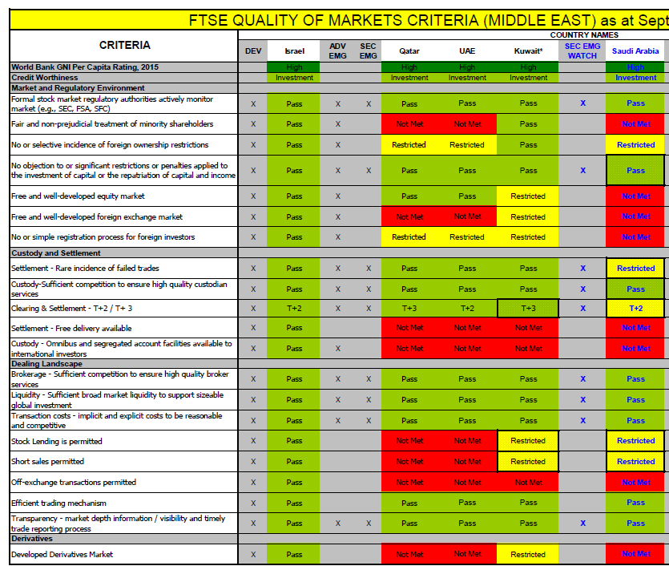
FTSE quality of market criteria September 2017

Slide 12
Preparing for the markets of the future, an exciting time for Kuwait.

Slide 13
How we can help
Product development and innovation
Collaborate to jointly develop new index solutions to meet changing market and client requirements
Bespoke benchmarks and full customization
Create and refine benchmarks in accordance with the specific needs of our clients
Market intelligence and analytics
Provide access to new market intelligence and analytics capabilities
Research collaboration
Work with our clients to research and share ideas on new initiatives and innovations
Marketing
Index marketing to support investment product providers’ sale of their products based on FTSE Russell indexes
Global data access
Provide access to a full range of extensive independent data maintained by FTSE Russell

Slide 14
What will FTSE Russell’s global clients be seeing ?
Constituent
A Constituent product reports the end-of-day/closing constituents of the index. This includes price data, market capitalisation and weightings of the constituents within the index.
It includes (amongst other items) the constituent name and other identifiers such as the ISIN, SEDOL, or CUSIP, the Exchange Code where the security is listed, the closing price, the dividend yield, size markers, the total market capitalisation, the investable market capitalization (the total market cap adjusted for free float and liquidity), the number of shares in issue, and the percentage weight of the constituent in the index.
Valuation
A Valuation product is produced after the market close and reports the index level, total return level and market capitalisations of the index.
The valuation product also provides subscribers with items such as the index code, number of constituents, the XD adjustment for the year to date, and the actual dividend yield of the constituents in the index.
Tracker
The Tracker product is produced after the market close and reports any corporate actions, divisor changes, and dividends paid in advance.
The product details all the corporate actions to the constituents of the indexes, including additions, deletions, the XD Adjustment (the ex dividend adjustment for the day), and changes arising from a variety of corporate events to be applied the next business day.

Slide 15
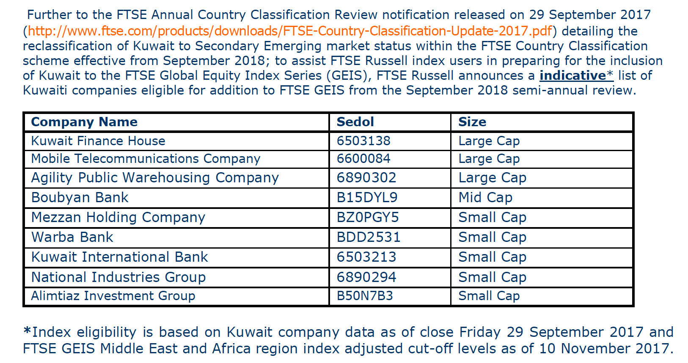
Provisional list of Kuwait stocks (to be updated 29th March 2018)

Slide 16
Looking ahead for Kuwait.
Ongoing product development (Regulation, Stock Exchange and Asset Management)
Investor education/profile
Liquidity
IPOs
Underlying companies
ESG

Slide 17
FTSE Quality of Markets Criteria
 | Developed | Advanced Emerging | Secondary Emerging | Frontier
World Bank GNI Per Capita Rating
Market and Regulatory Environment
Formal stock market regulatory authorities actively monitor market (e.g., SEC, FSA, SFC) | X | X | X | X
Fair and non-prejudicial treatment of minority shareholders | X | X
No or selective incidence of foreign ownership restrictions | X | X
No objections or significant restrictions or penalties applied to the investment of capital or the repatriation of capital and income | X | X | X | X
Free and well-developed equity market | X | X
Free and well-developed foreign exchange market | X | X
No or simple registration process for foreign investors | X | X
Custody and Settlement
Settlement - Rare incidence of failed trades | X | X | X | X
Custody-Sufficient competition to ensure high quality custodian services | X | X | X
Clearing & settlement - T + 2 / T+3 | X | X | X | X
Settlement - Free delivery available | X
Custody - Omnibus account facilities available to international investors | X | X
Dealing Landscape
Brokerage - Sufficient competition to ensure high quality broker services | X | X | X
Liquidity - Sufficient broad market liquidity to support sizeable global investment | X | X | X
Transaction costs - implicit and explicit costs to be reasonable and competitive | X | X | X
Stock Lending is permitted | X
Short sales permitted | X
Off-exchange transactions permitted | X
Efficient trading mechanism | X
Transparency - market depth information / visibility and timely trade reporting process | X | X | X | X
Derivatives
Developed Derivatives Market | X
Notes:
Purpose: Ice breaker, to show that index calculation took a long time to take off (300+ yrs) and the first exchange traded debt, then currency, then equities. A Stock exchange and share certificate only introduced 80 years after debt exchanges. The data reporting industry upon which index providers depend was driven by the introduction of the first Ticker in 1867 and then the formation of Extel. The introduction of first index DJI.
Key Take Aways.
Exchanges aswe know them have been around for a long time
Initial index development was slow
************************************************************
First large scale trading of standard instruments – debt Venetians C13
First Debt market – Antwerp 1531
First Currency Market – Frankfurt 1585
First Stock Market – Amsterdam 1611
First US exchange – Philidelphia 1790 ( NYSE 1792) now owned by NASDAQ ( founded 1971)
First Ticker Tape – NYSE 1867
First exchange reporting company – London Extel 1872 ( LSE & NYSE)
Exchanges today have their format and origin in the European exchanges and laws
DJI In a price - weighted index such as the Dow Jones Industrial Average, the price of each component stock is the only consideration when determining the value of the index
Extel now part of Thomson Reuters

Slide 18
Definitions of Economic/Market Status
Category | Definitions of Economic Status | Quality of Markets Criteria | Other Entry Requirements
Developed | High Income GNI countries with developed market infrastructures | Passes 21 of 21 Q of M Criteria | Quality of Markets only
Advanced Emerging | Upper Middle Income GNI countries with advanced market infrastructures and High Income GNI countries with lesser developed market infrastructures | Passes 15 of 21 Q of M Criteria
Secondary Emerging | Lower Middle countries with reasonable market infrastructures and Upper Middle Income GNI countries with lesser developed market infrastructures | Passes 9 of 21 Q of M Criteria | Minimum 3 eligible companies
Frontier | Restricted emerging markets | Passes 5 of 21 Q of M Criteria | Minimum 3 eligible companies

Slide 19
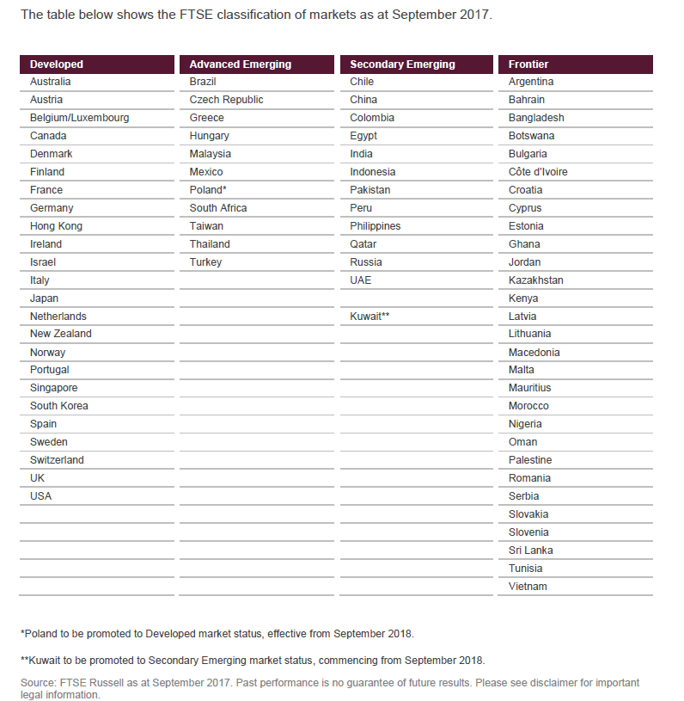

Slide 20
FTSE Russell Watch List countries
China A-Shares: Possible inclusion as Secondary Emerging
Iceland: Possible inclusion as Frontier
Romania: Possible reclassification from Frontier to Secondary Emerging
Saudi Arabia: Possible inclusion as Secondary Emerging in March 2018

Slide 21
Contact
Gary Rynhoud
Head of Middle East and Africa FTSE Russell
10 Paternoster Square London EC4M 7LS Tel: +44 207 866 8069 Mobile: +44 79 891 63831 Email: grynhoud@ftserussell.com

Slide 22
Thank you

Slide 23
Disclaimer
© 2018 London Stock Exchange Group plc and its applicable group undertakings (the “LSE Group”). The LSE Group includes (1) FTSE International Limited (“FTSE”), (2) Frank Russell Company (“Russell”), (3) FTSE TMX Global Debt Capital Markets Inc. and FTSE TMX Global Debt Capital Markets Limited (together, “FTSE TMX”), (4) MTSNext Limited (“MTSNext”), (5) Mergent, Inc. (“Mergent”), (6) FTSE Fixed Income LLC (“FTSE FI”) and (7) The Yield Book Inc. (“YB”). All rights reserved.
FTSE Russell® is a trading name of FTSE, Russell, FTSE TMX, MTS Next Limited, Mergent, FTSE FI and YB. “FTSE®”, “Russell®”, “FTSE Russell®”, “MTS®”, “FTSE TMX®”, “FTSE4Good®”, “ICB®”, “Mergent®” , “WorldBIG®”, “USBIG®”, “EuroBIG®”, “AusBIG®”, “The Yield Book®”, and all other trademarks and service marks used herein (whether registered or unregistered) are trademarks and/or service marks owned or licensed by the applicable member of the LSE Group or their respective licensors and are owned, or used under licence, by FTSE, Russell, MTSNext, FTSE TMX, Mergent, FTSE FI or YB.
All information is provided for information purposes only. All information and data contained in this publication is obtained by the LSE Group, from sources believed by it to be accurate and reliable. Because of the possibility of human and mechanical error as well as other factors, however, such information and data is provided "as is" without warranty of any kind. No member of the LSE Group nor their respective directors, officers, employees, partners or licensors make any claim, prediction, warranty or representation whatsoever, expressly or impliedly, either as to the accuracy, timeliness, completeness, merchantability of any information or of results to be obtained from the use of the FTSE Russell Indexes or the fitness or suitability of the FTSE Russell Indexes for any particular purpose to which they might be put. Any representation of historical data accessible through FTSE Russell Indexes is provided for information purposes only and is not a reliable indicator of future performance.
No responsibility or liability can be accepted by any member of the LSE Group nor their respective directors, officers, employees, partners or licensors for (a) any loss or damage in whole or in part caused by, resulting from, or relating to any error (negligent or otherwise) or other circumstance involved in procuring, collecting, compiling, interpreting, analysing, editing, transcribing, transmitting, communicating or delivering any such information or data or from use of this document or links to this document or (b) any direct, indirect, special, consequential or incidental damages whatsoever, even if any member of the LSE Group is advised in advance of the possibility of such damages, resulting from the use of, or inability to use, such information.
No member of the LSE Group nor their respective directors, officers, employees, partners or licensors provide investment advice and nothing contained in this document or accessible through FTSE Russell Indexes, including statistical data and industry reports, should be taken as constituting financial or investment advice or a financial promotion.
Past performance is no guarantee of future results. Charts and graphs are provided for illustrative purposes only. Index returns shown may not represent the results of the actual trading of investable assets. Certain returns shown may reflect back-tested performance. All performance presented prior to the index inception date is back-tested performance. Back-tested performance is not actual performance, but is hypothetical. The back-test calculations are based on the same methodology that was in effect when the index was officially launched. However, back- tested data may reflect the application of the index methodology with the benefit of hindsight, and the historic calculations of an index may change from month to month based on revisions to the underlying economic data used in the calculation of the index.
This publication may contain forward-looking assessments. These are based upon a number of assumptions concerning future conditions that ultimately may prove to be inaccurate. Such forward-looking assessments are subject to risks and uncertainties and may be affected by various factors that may cause actual results to differ materially. No member of the LSE Group nor their licensors assume any duty to and do not undertake to update forward-looking assessments.
No part of this information may be reproduced, stored in a retrieval system or transmitted in any form or by any means, electronic, mechanical, photocopying, recording or otherwise, without prior written permission of the applicable member of the LSE Group. Use and distribution of the LSE Group data requires a licence from FTSE, Russell, FTSE TMX, MTSNext, Mergent, FTSE FI, YB and/or their respective licensors

